Slide 1
Smart City: Traffic prediction using Deep Learning
Randa Almohammadi Banan Alhethlool Leena AlQasem

Slide 2
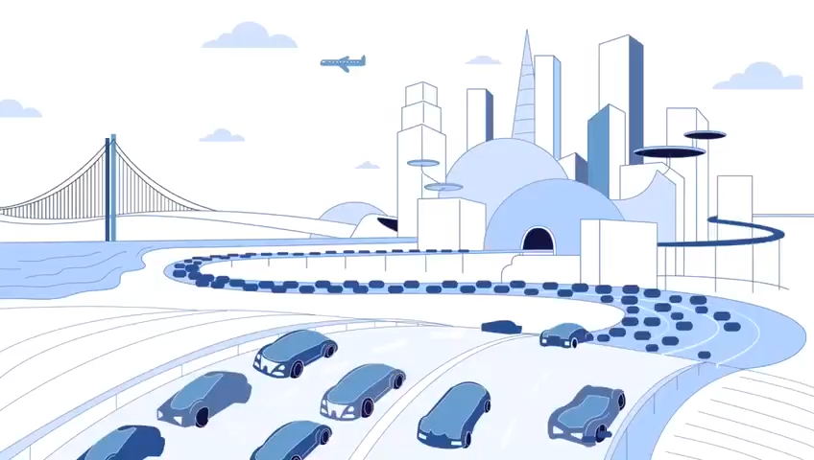

Slide 3
TABLE OF CONTENTS
01
02
03
INTRODUCTION
DATASET
TOOLS & LIBRARIES
04
05
06
METHODOLOGY
RESULTS ANALYSIS
CONCLUSION
01

Slide 4
INTRODUCTION
BRIEF DESCRIPTION
Traffic is a PROBLEM!
Smart cities can avoid the problem.
PROJECT OBJECTIVE
Analyzing and predicting traffic.
Help smart cities understand traffic patterns.
02

Slide 5
DATASET
DATA SOURCE
Kaggle as an open-source.
Sensors at every junction.
48120
COLUMNS
RECORDS
4
03

Slide 6
TOOL & LIBRARIES
JUPYTER
MATPLOTLIB
PYTHON
SCIKIT-LEARN
PANDAS
KERAS
NUMPY
TENSORFLOW
SEABORN
04

Slide 7
METHODOLOGY
1
3
5
2
4
FEATURE Engineering
DEEP LEARNING
MODELING
DATA EXPLORATION
Exploratory data analysis
FEATURE SCALING
05

Slide 8
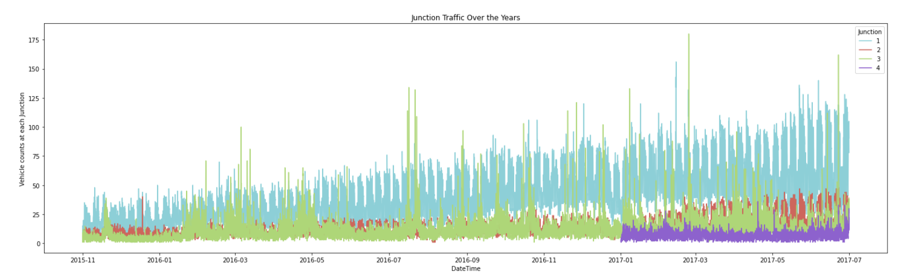
EXPLORATORY DATA ANALYSIS
48000+
Total observations
4
+1,000,000
2015-2017
Traffic increases over the year.
06

Slide 9
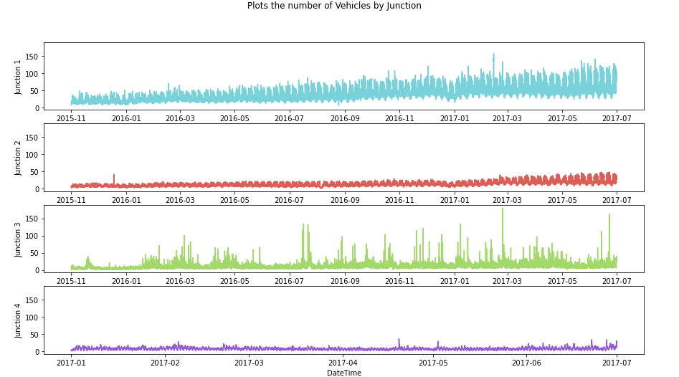
EXPLORATORY DATA ANALYSIS
48000+
Total observations
4
+1,000,000
2015-2017
Timeseries of traffic for each junction over the year.
07

Slide 10
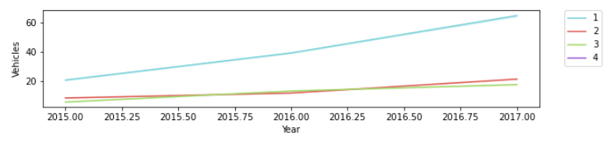
EXPLORATORY DATA ANALYSIS
48000+
Total observations
4
+1,000,000
All three junctions have an upward trend except the fourth.
2015-2017
08

Slide 11
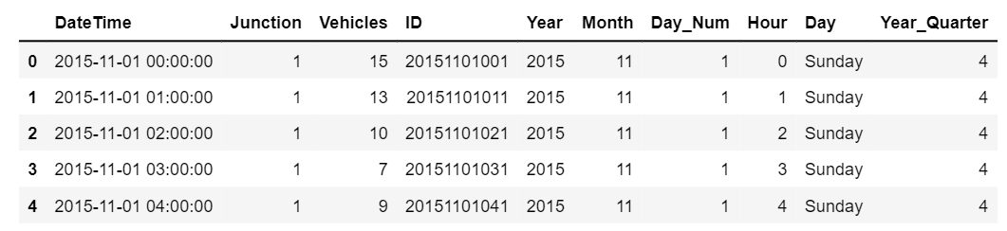
FEATURE ENGINEERING
1
2
Dropping unnecessary columns
Formatting the
datetime
09

Slide 12
FEATURE SCALING
Normalization
Differencing
Average & STDV
1
2
Week difference
Day difference
Hour difference
10

Slide 13
DEEP LEARNING MODEL
Split data:
Split on junction base
Split data for 85% training and 15% testing
Gated Recurrent Unit (GRU)
11

Slide 14
GATED RECURRENT UNIT (GRU)
The Developed Model of RNN
Solves the short time memory
Solves the vanishing gradient
Six Layers
Tanh as the activation function
SGD as the optimizer
12

Slide 15
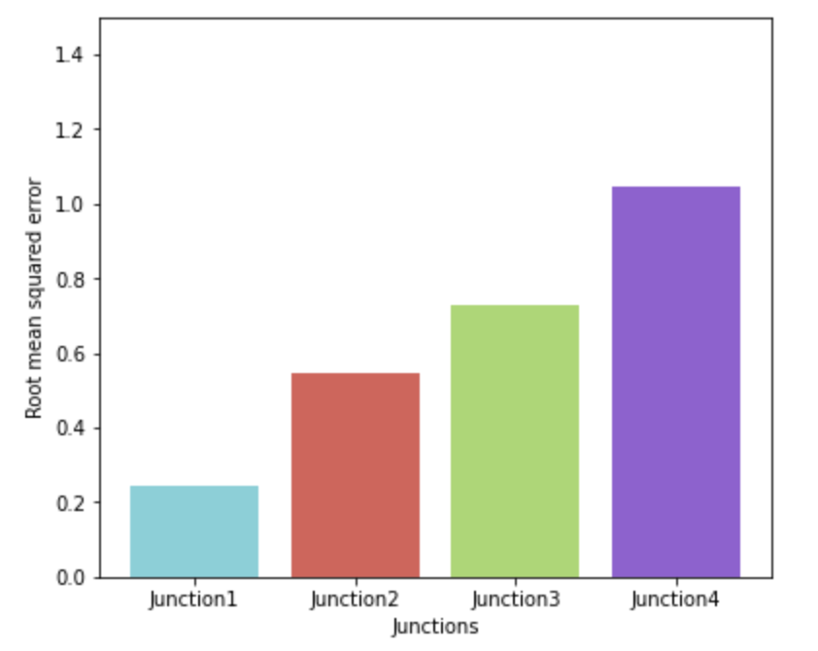
RESULTS AND ANALYSIS
Epochs
35
JUNCTIONS | RMSE
Junction 1 | 0.2443
Junction 2 | 0.5470
Junction 3 | 0.7337
Junction 4 | 1.0391
13

Slide 16
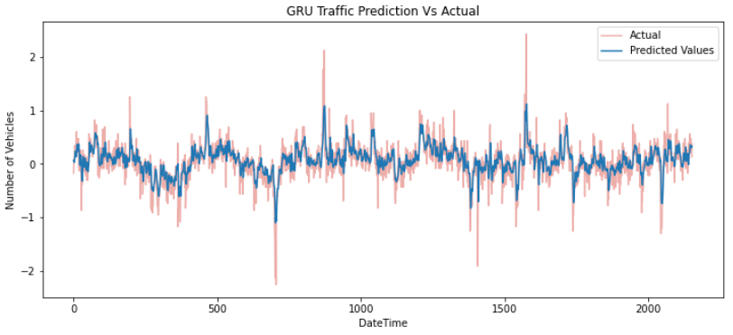
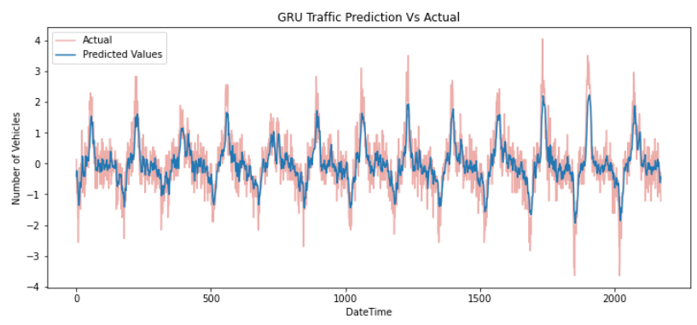
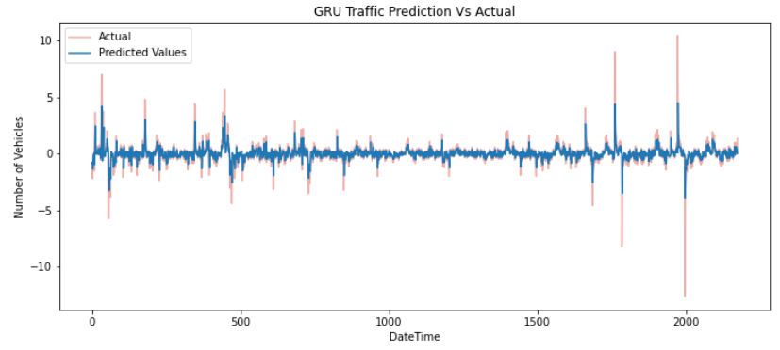
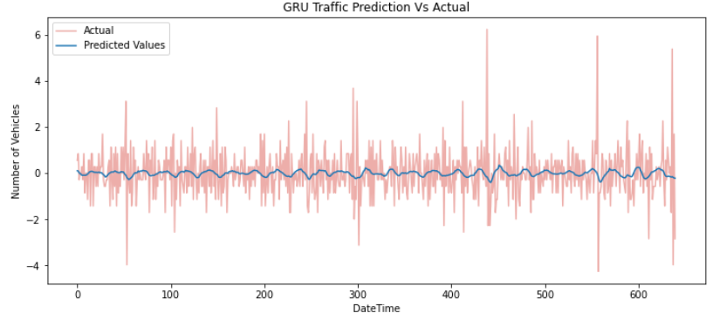
RESULTS AND ANALYSIS
Junction 1
Junction 2
Junction 3
Junction 4
14

Slide 17
CONCLUSION
Summary
Recommendations:
Traffic Prediction
Junctions Data
GRU model
Infrastructure
Smart cities
Improve Traffic Management
15

Slide 18
THANKS!
Do you have any questions?

